Slide 1
Lecture 8

Slide 2
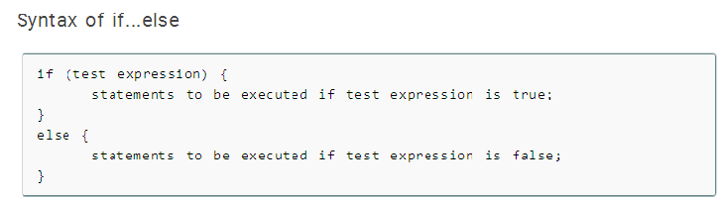
C if...else statement
The if...else statement is used if the programmer wants to execute some statement/s when the test expression is true and execute some other statement/s if the test expression is false.

Slide 3
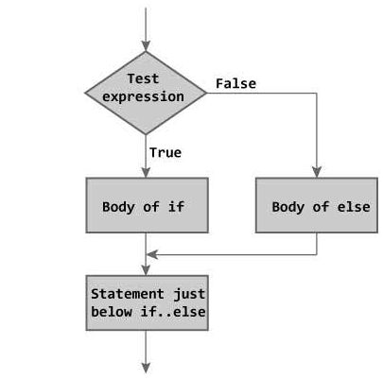
Flowchart of if...else statement

Slide 4
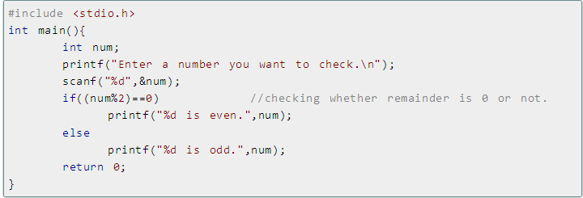
Let us consider an example:
Write a C program to check whether a number entered by user is even or odd

Slide 5
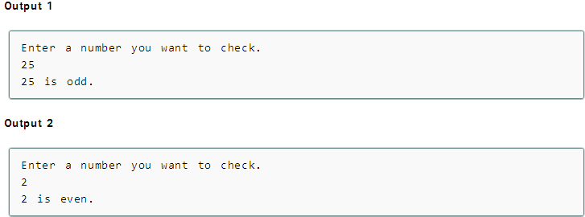

Slide 6
Nested if...else statement (if...elseif....else Statement)
Syntax of nested if...else statement.
if (test expression1)
{
statement/s to be executed if test expression1 is true;
}
else if(test expression2)
{
statement/s to be executed if test expression1 is false and 2 is true;
}
else if (test expression 3)
{
statement/s to be executed if text expression1 and 2 are false and 3 is true;
}
.
.
.
else
{
statements to be executed if all test expressions are false;
}

Slide 7
How nested if...else works?
The nested if...else statement has more than one test expression.
If the first test expression is true, it executes the code inside the braces{ } just below it.
But if the first test expression is false, it checks the second test expression. If the second test expression is true, it executes the statement/s inside the braces{ } just below it.
This process continues. If all the test expression are false, code/s inside else is executed and the control of program jumps below the nested if...else.
The ANSI standard specifies that 15 levels of nesting may be continued.

Slide 8
Let’s consider another example:
#include <stdio.h>
int main()
{
int age;
printf( "Please enter your age" );
scanf( "%d", &age );
if ( age < 100 ) {
printf ("You are pretty young!\n" );
}
else if ( age == 100 ) {
printf( "You are old\n" );
}
else {
printf( "You are really old\n" );
}
return 0;
}

